Slide 1


Slide 2
Entity Relationship Diagrams (ERD)

Slide 3
ERD Model
Entity-Relationship, ER Model
ER model describes data as entities, relationships and attributes
A picture that shows how data is related together
Entity
A “thing” in the real world with an independent existence
Physical existence
Person, car, house or employee
Conceptual existence
Company, job, university course
Entities become tables

Slide 4
ERD Model
Attribute
Properties that describes the entity
Used to distinguish one thing from another
Examples:
EmployeeName
Address,
Age
HomePhone
CompanyName,
Headquarters
President
Attributes become the columns of a table

Slide 5
Entity
An entity defines a collection object that have the same attributes
Entity is described by its name and attributes
Examples:
Employee [Number, Name, Title, Salary]
Project [Number, Budget, Location]

Slide 6
Drawing ERD’s
There are a variety of tools available to draw ERDs
ERDs can also be drawn by hand (although this is almost never done)
Different packages do things different ways
We will use ‘ERAssistant’ this term, but in the future you will use Visual Paradigm

Slide 7
Drawing ERD’s
Download ERAssistant using the link in Learn
Start ERAssistant
On the menu click
File->
New
This creates a blank window to draw an ERD

Slide 8
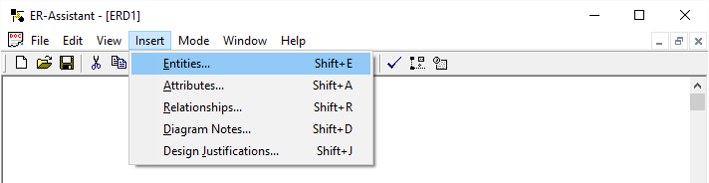
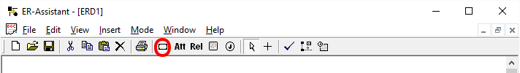
ER Notation
First thing drawn is an entity
Click Insert Entities to bring up Entities dialog box
You may also just click on Entities on the toolbar

Slide 9
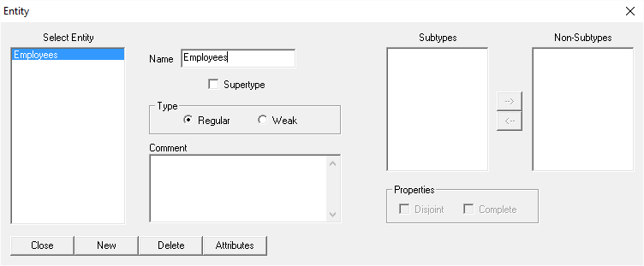
ER Notation
Give the entity a proper name:
Click on the New button, and type in the Name field
Call it ‘Employees’
Don’t worry about the other options. Click Close when completed.

Slide 10
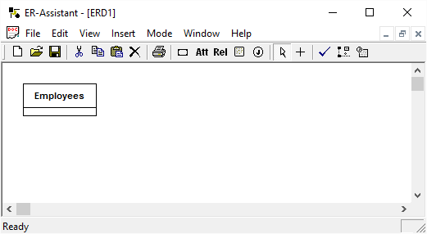
ER Notation
Entity
Rectangular box
Enclosing the entity name
Name centered at top of box
There are several types of ERD’s you can draw – entities with only the entity name are the most basic

Slide 11
ER Notation
Attributes
Added for the more complex types of ERD’s
Entities may contain
Primary Key attributes only
All attributes

Slide 12
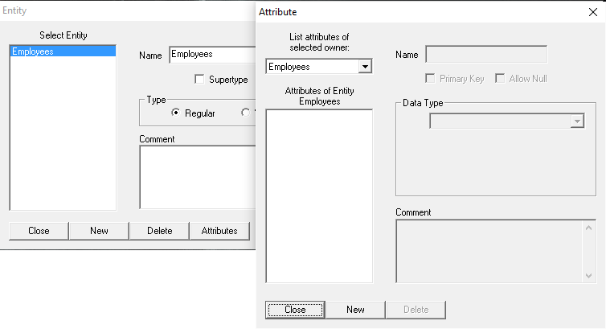
ER Notation
To define attributes:
Double click on the Entity
Click on the Attributes button
Click New, and type in the Attribute Name EmpID

Slide 13
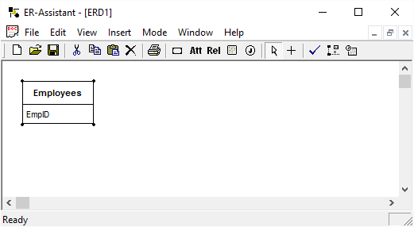
ER Notation
Click Close to close the Attributes dialog box.
Click close to close Entities.
Your ERD should now look like this:

Slide 14
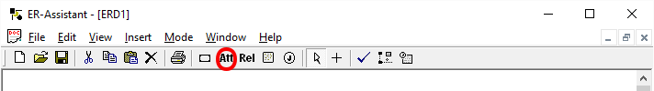
ER Notation
Attributes
This can also be done from the New → Attribute menu option, and select the Employees entity and assign Attributes to it
You may also click on the Attributes button on the tool bar

Slide 15
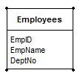
Attribute Notations
Keyed Attributes
Any value that is a Primary Key or a Foreign Key
Are indicated with special markings on the ERD
Non-key attributes
Are not a part of the primary key, nor are they foreign keys
Add the EmpName and DeptNo Attributes
In this diagram all attributes are non-key

Slide 16
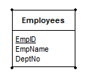
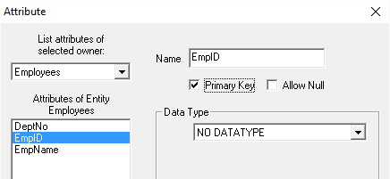
Attribute Notations
Primary Key Attributes
Underlined
ERAssistand does this automatically when we set an Attribute to Primary Key

Slide 17
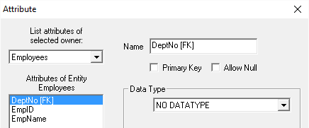
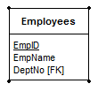
Attribute Notations
Foreign Key Attributes
Suffixed with ‘[FK]’
ERAssistant does not have anything to indicate Foreign Keys columns, so we add [FK] to the name
Other products do indicate foreign keys for you…

Slide 18
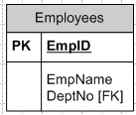
Attribute Notations
Regular Attributes
Listed as is
In this diagram the only non-key attribute is EmpName

Slide 19
Relationships
A relationship logically associates two or more entities with each other
Binary relationship associates two entities
Ternary relationship associates three entities with each other
N-ary relationship associates n entities with each other

Slide 20
Relationships on the ERD
A line connects entities that have relationships
If no lines connect entities, there is no relationship
Each relationship is named
A verb that describes the relationship between entities
Appears beside the line connecting the entities
All relationships in an ERD must have a unique name

Slide 21
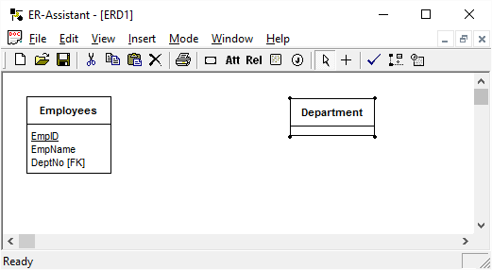
Relationships
Add another entity called Department, moving it to a suitable place on your ERD

Slide 22
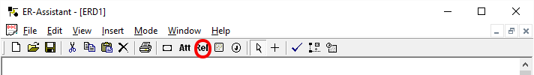
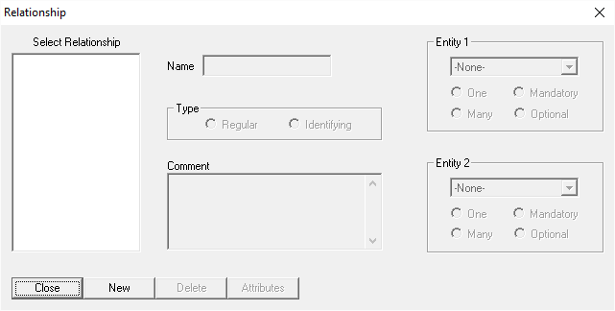
Relationships
Click on ‘Relationships’ under Insert, or Relationship’s button on toolbar
The Relationship dialog box should show

Slide 23
Relationships
As before, click New Relationship, give it a name like Work, and define the two entities in this relationship, Employees and Departments
We will use the Identifying radio button to make a solid like connection between entities in this course.
Don’t worry about other options

Slide 24
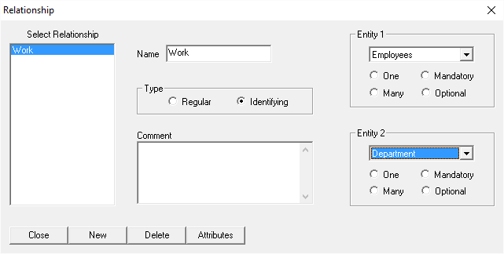
Relationships
Your Relationship dialog box should look like this. Click Close, and drag your Relationship name on your ERD until it looks good.

Slide 25
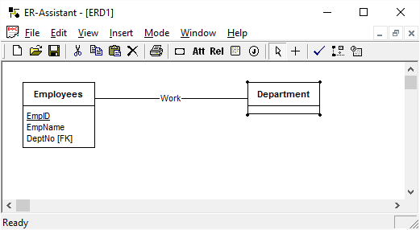
Relationships
Your ERD should now look like this. Again, drag Entities and Relationships around until it is well laid out.

Slide 26
Create an ERD
Create an ERD based on the following:
Supplier [Number, Name, Location]
Project [Number, Name, PartNumber]
Part [Number, Name, Quantity, Weight, SupplierNumber]
Employee [Number, Name, Address, Salary, Project]

Slide 27
Saving/Submitting Work
Once you have completed your ERD, you can save it as a .erd document. For submission purposes, you may also select all items in ERAssistant (Ctrl + A), copy (Ctrl + C) and go to your word processor (Word most likely) and paste (Ctrl + V) and it should embed the ERD as an image in your document.

